Slide 1
Analyzing Smart Devices Fitness Data
Presented By : Sandip Deb
Contact Info:
Email : debsandip.agt@gmail.com
LinkedIn : linkedin.com/in/sandip-deb-22b606b3
Last Update : 23rd August 2022

Slide 2
Table of Contents
Analyzing Smart Device Fitness Data
Purpose Statement(Description of business task)
Description of all data sources
Documentation of cleaning or manipulation of data
Summary of analysis
Tell Your story (with Data)
Conclusion
Appendix

Slide 3
In order to gain insight into how consumers use non-Bellabeat smart devices, analyzing smart device fitness data could help unlock new growth opportunities for the company.
Description of business task

Slide 4
Description of Data sources
Are Data Sets Available? | Yes
Dataset List | The Data set can be downloaded from the link given in the below section
Websites to scrape the data needed* | FitBit Fitness Tracker Data | Kaggle
About Dataset | This dataset generated by respondents to a distributed survey via Amazon Mechanical Turk between 03.12.2016-05.12.2016. Thirty eligible Fitbit users consented to the submission of personal tracker data, including minute-level output for physical activity, heart rate, and sleep monitoring.

Slide 5
Checklist followed during Data Cleaning Process
Eliminate duplicate data
Repair incorrect data
Handle missing data
Remove irrelevant data
Filter outlying data
Validate and QA data
Note:- Documentation of cleaning and manipulation of data is in the attached Markdown file.

Slide 6
__________________ *Presenting Data

Slide 7
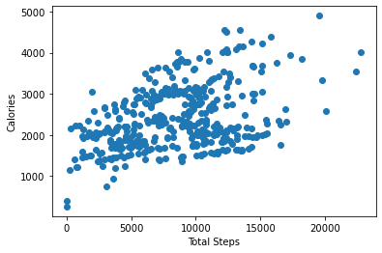
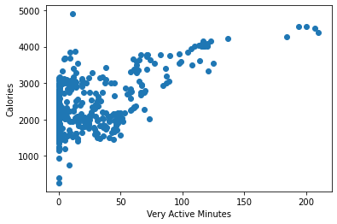
There is a positive correlation between Calories vs Total step and Very active Minutes. Below two pictures clearly shows that When losing weight, more physical activity increases the number of calories your body uses for energy or “burns off.” The burning of calories through physical activity, combined with reducing the number of calories you eat, creates a “calorie deficit” that results in weight loss.

Slide 8
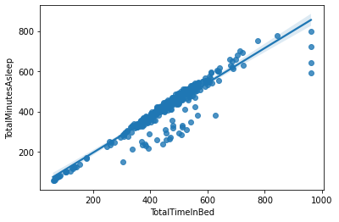
Sleep*
The relationship between Total Minutes Asleep and Total Time in Bed looks linear.
So if the Bellabeat users want to improve their sleep, we should consider using notification to go to sleep.

Slide 9
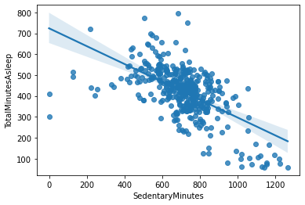
Sedentary Minutes Vs Total Minutes Asleep
The above plot clearly shows that Sedentary Minutes is *negatively correlated to Total Minutes Asleep. so, if Bellabeat users want to improve their sleep, Bellabeat app can recommend reducing sedentary time.

Slide 10
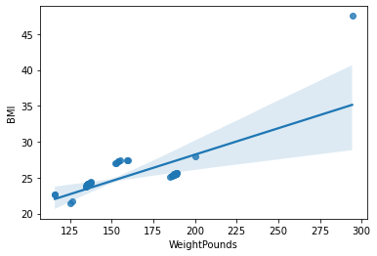
BMI Vs Weight Pounds
Are weight and BMI correlated?
BMI is an inexpensive and easy screening method for weight category—underweight, healthy weight, overweight, and obesity. BMI does not measure body fat directly, but BMI is moderately correlated with more direct measures of body fat.

Slide 11
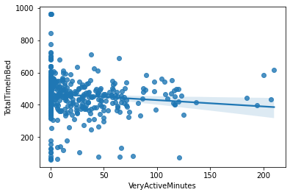
Bed Time:-
The plot shows that there is less or no correlation between Total Time In Bed and Very Active Minutes.

Slide 12
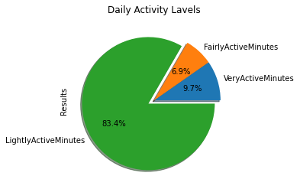
Active levels of users
This above pie chart is clearly showing that 83% participants are lightly active which is more then majority.
So, At least 150 minutes a week of moderate intensity activity such as brisk walking. At least 2 days a week of activities that strengthen muscles. Activities to improve balance such as standing on one foot. Aim for the recommended activity level but be as active as one is able.

Slide 13
Description of Statistical Summary:- * Mean value is average value. * Higher standard deviation means maximum value is not closest to the mean. * 25% data is lest hen given value. * 50% data is less then given value. * 75% data is less then given value. * max is the maximum value. * min is the minimum value.

Slide 14
Conclusion:-
if the Bellabeat users want to improve their sleep, we should consider using notification to go to sleep and Bellabeat app can recommend reducing sedentary time as well.
more physical activity increases the number of calories your body uses for energy or “burns off.
For lightly active people it is recommended that At least 150 minutes a week of moderate intensity activity such as brisk walking is necessary.
BMI is moderately correlated with more direct measures of body fat.
* Doesn't mean there is casual effect.
Further analysis needed.

Slide 15
*Appendix
Git Hub link for project related documents
https://github.com/debsandipagt/Project_Analyzing-Smart-Devices-Fitness-Data.git

Slide 16
Thank You

